Slide 1

Fakultas Ilmu Komputer
Learning is the process of acquiring new understanding, knowledge, behaviors, skills, values, attitudes, and preferences.
Framework #5 View

Slide 2

Welcome to the Framework Programming course

Slide 3

1 - What is the view in MVC framework architecture?

Slide 4
Three Important MVC Components (layers)
Component #1  Model :
The model component stores data and its related logic. It represents data that is being transferred between controller components or any other related business logic. For example, a Controller object will retrieve the customer info from the database. It manipulates data and send back to the database or use it to render the same data.
It responds to the request from the views and also responds to instructions from the controller to update itself. It is also the lowest level of the pattern which is responsible for maintaining data.
Component #2  View :
The View is that part of the application that represents the presentation of data.
Views are created by the data collected from the model data. A view requests the model to give information so that it resents the output presentation to the user.
The view also represents the data from chats, diagrams, and table. For example, any customer view will include all the UI components like text boxes, drop downs, etc.
Component #3  Controller :
The Controller is that part of the application that handles the user interaction. The controller interprets the mouse and keyboard inputs from the user, informing model and the view to change as appropriate.
A Controller send's commands to the model to update its state (E.g., Saving a specific document). The controller also sends commands to its associated view to change the view's presentation (For example scrolling a particular document).
The paper was published under the title:
Burbeck, Steve. "Applications programming in smalltalk-80 (tm): How to use model-view-controller (mvc)." Smalltalk-80 v2 5 (1992): 1-11.

Slide 5



Three Important MVC Components (layers)
Model: It includes all the data and its related logic.
View: Present data to the user or handles user interaction.
Controller: An interface between Model and View components.

Slide 6
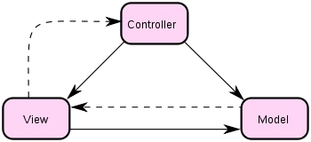
Three Important MVC Components (layers)
logic program (controller)
Tampilan (view) => UI
Manage the data

Slide 7

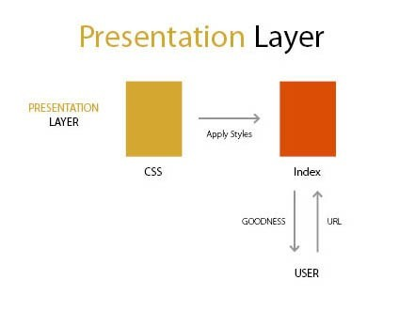
Component #2  View (Presentation)
Responsible to display the data provided by the model in a specific format.
A view is responsible for UI (user interface). View displays the data coming from the model.

Slide 8
Component #2  View (Presentation)
View in MVC is a user interface. A view is used to display data to the user using the model class object and also enables users to modify them.

Slide 9
Types of Views
Normal view It's the same as web page. To create this view we use the view page template, (MVC to view page template in MVC application).
Partial view It's the same as user control. Partial views are similar to the user controller.
Layout View It's the same as a master page. To create a master page view we use a template.
Read Source:
https://tekslate.com/many-types-view-mvc

Slide 10
2 – Basic display the page from
“home & project” view.

Slide 11
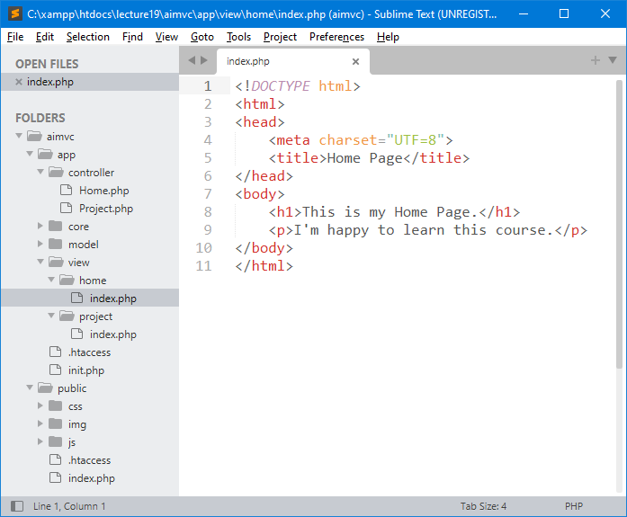
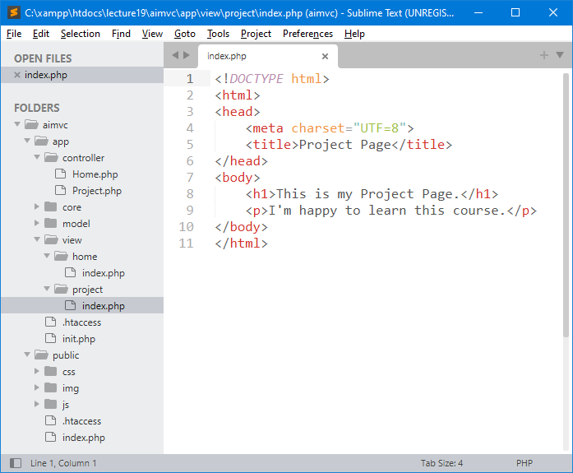
1 - Create Subdirectory in View
/view/home/index.php
/view/project/index.php
The <!DOCTYPE html> declaration defines that this document is an HTML5 document
The <html> element is the root element of an HTML page
The <head> element contains meta information about the HTML page
The <title> element specifies a title for the HTML page (which is shown in the browser's title bar or in the page's tab)
The <body> element defines the document's body, and is a container for all the visible contents, such as headings, paragraphs, images, hyperlinks, tables, lists, etc.
The <h1> element defines a large heading
The <p> element defines a paragraph

Slide 12
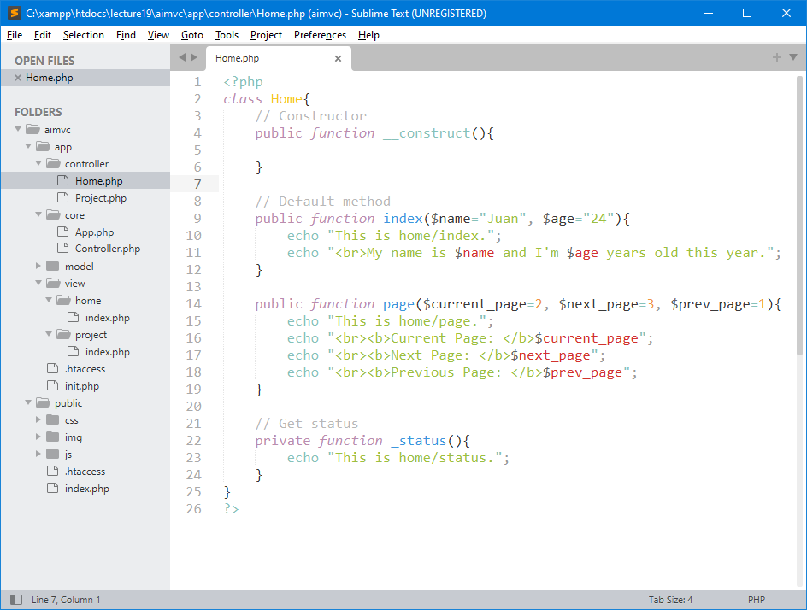
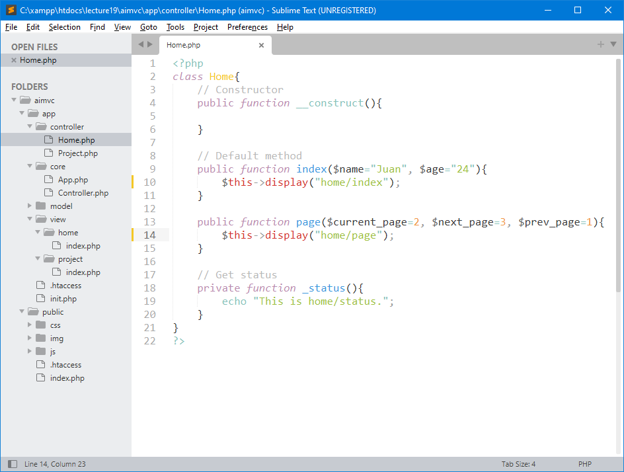
2 – Display Page from View
We handle this action from Controller. See, before and after changing code.
Code before change
Code after change
$this->view("home/index");
Note, please see the selection file in left side tree menu. This code means you want to access index.php in home subdirectory which is located in view directory.

Slide 13
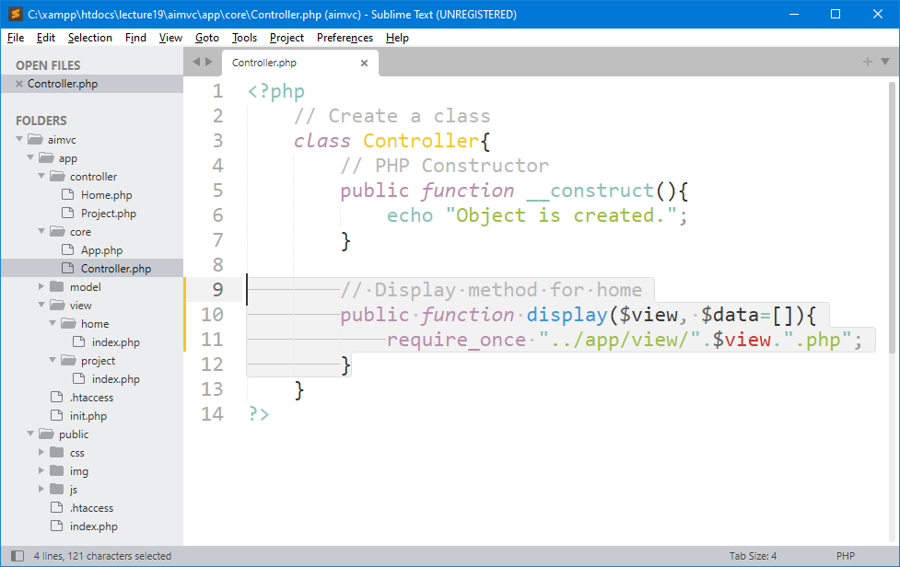
3 – Create Method display() in Core Controller
In variable “view” may contains value like “home/index”. This function will require file from view directory to get specific page and display it, like home page.

Slide 14
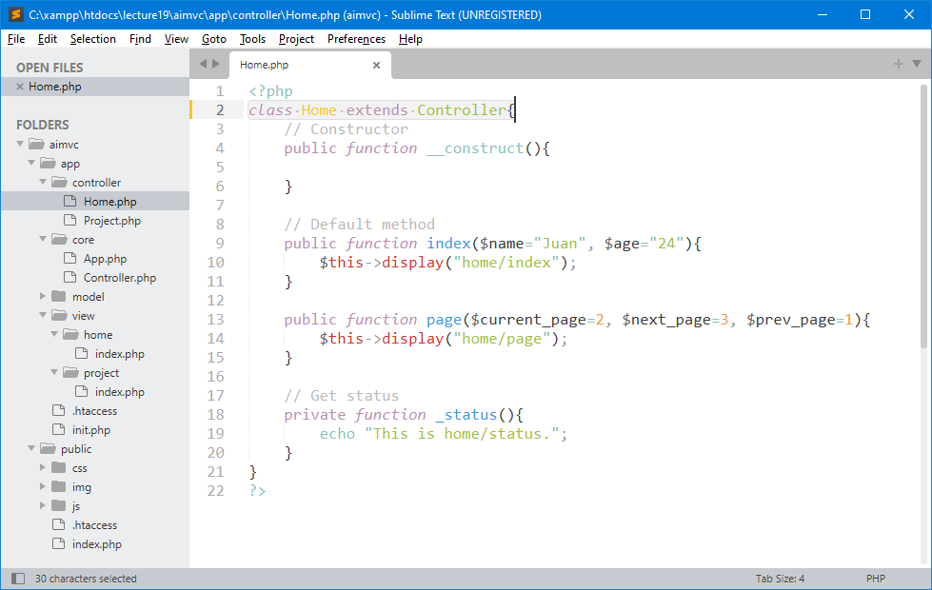
4 – Inherit display () Function
Last step in this stage is to inherit this display() function to the controller class. The extends keyword is used to derive a class from another class. This is called inheritance.
This controller class in core directory inherits all function to home class in controller directory.

Slide 15
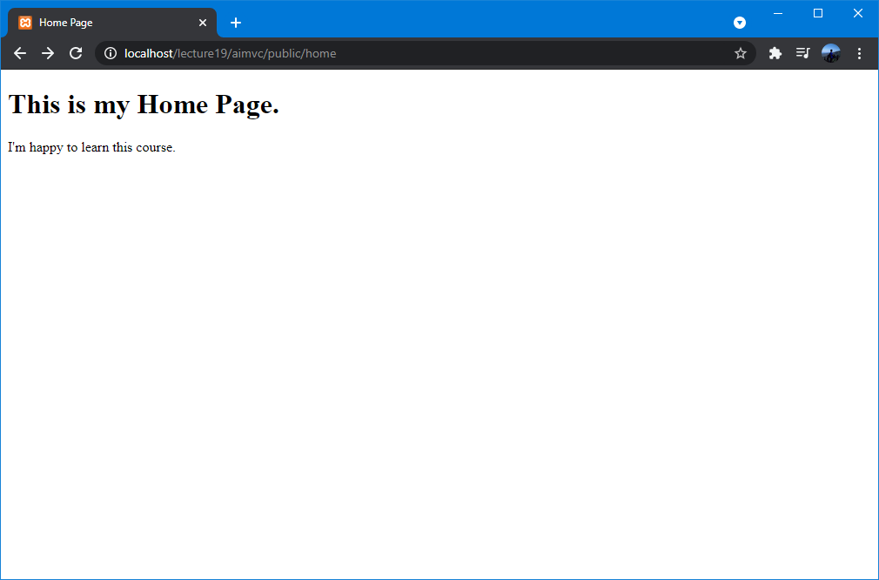
5 - Testing – View Home Page
You can use these URLs to access your first home page.
URL: http://localhost/lecture19/aimvc/public/home
http://localhost/lecture19/aimvc/public/home/index/

Slide 16
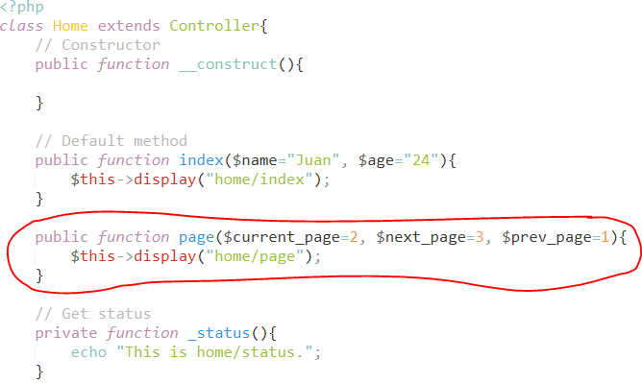
How to access this method page() in the home class? It will display an error if you force to access this method from the URL.

Slide 17
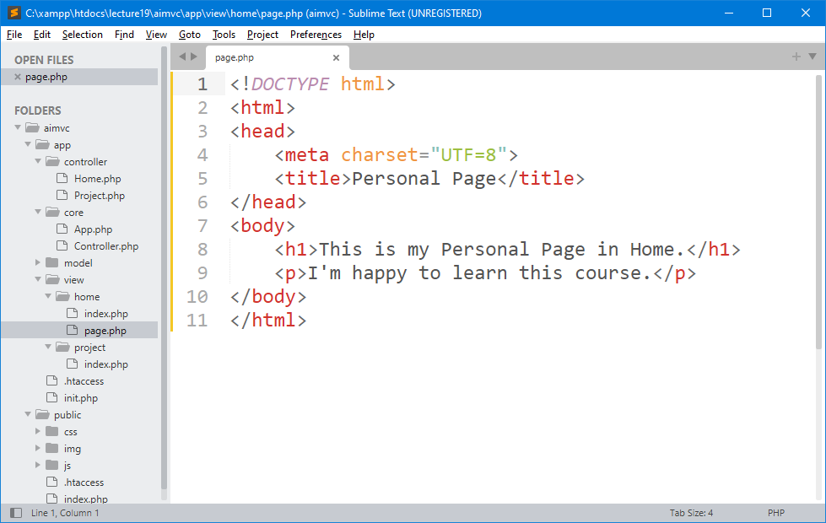
6 – Create page.php in view/home Directory
Display another page from “home” view directory by creating new page.php file.

Slide 18
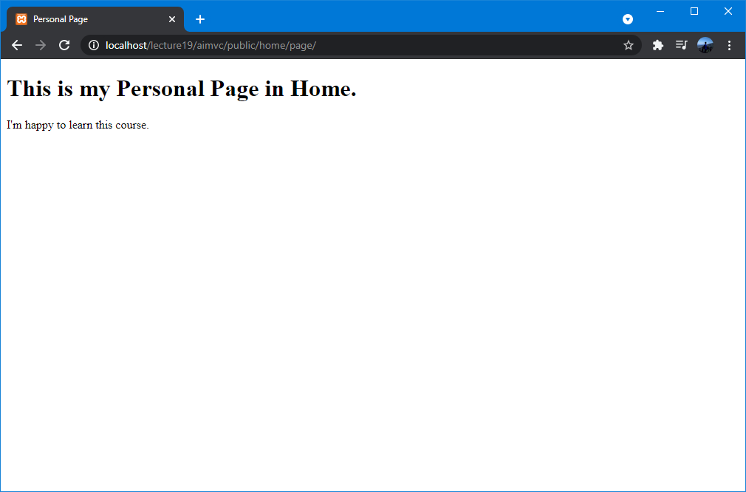
5 - Testing  View Personal Page
You can use these URLs to access your first home page.
URL: http://localhost/lecture19/aimvc/public/home/page/

Slide 19
3 – Send and Receive Data from URL

Slide 20
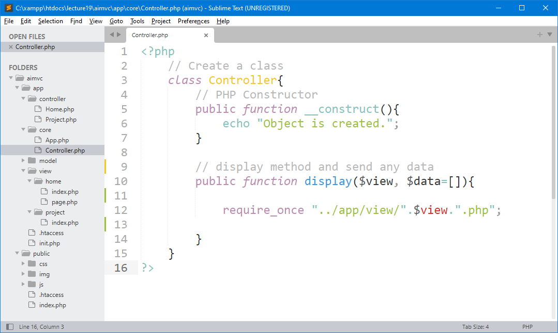
1 – Check display() Method with Parameter Data
In the previous step, we have already created a display() method for a core Controller class with parameter data which can be used to send data.

Slide 21
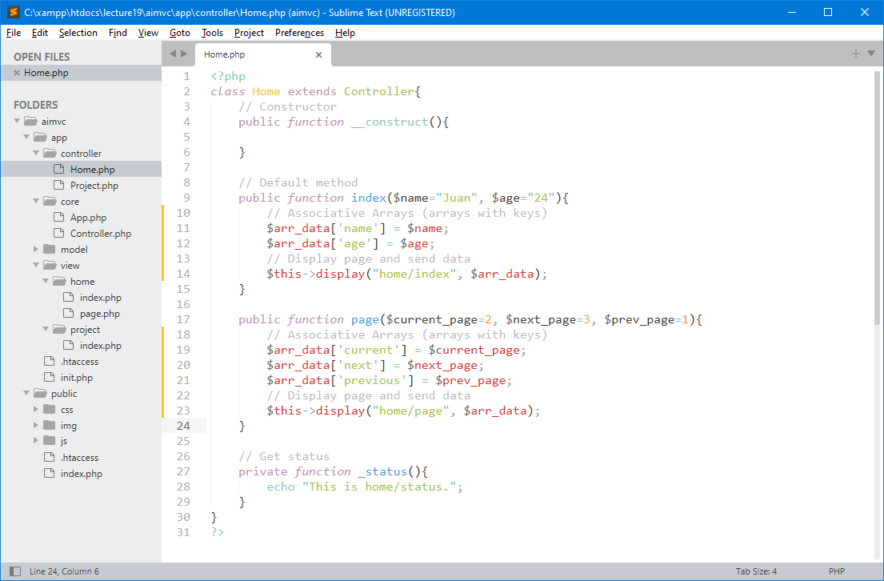
2 - Assign an Associative Arrays to Method
Now, you can send your data to the target method which can help you to display your data in the target page.

Slide 22
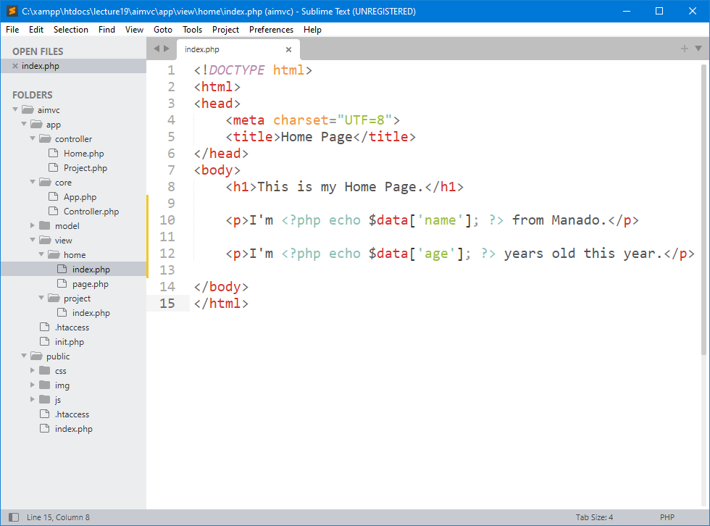
3 – Receive data from display() Parameter
Now, go to index.php page in the home view directory and modify by following this code. You are trying to view the name and age in your home page.

Slide 23
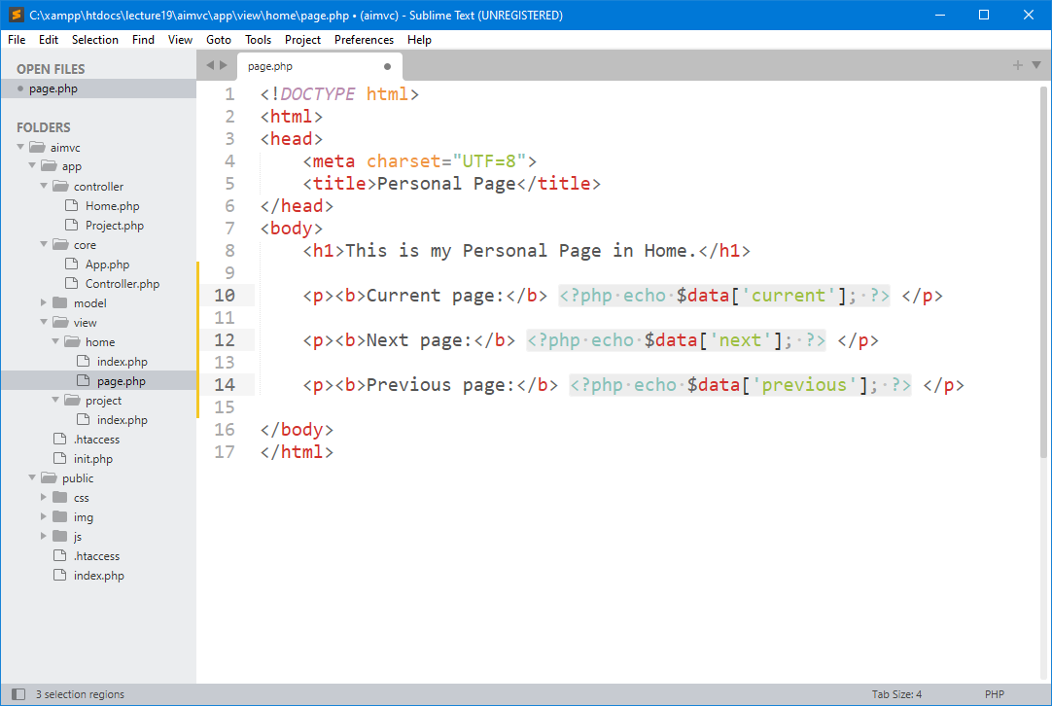
4 – Also Modify page.php file in Home Directory
Here, it is actually the same. You only need to set the data and display it to the page.

Slide 24
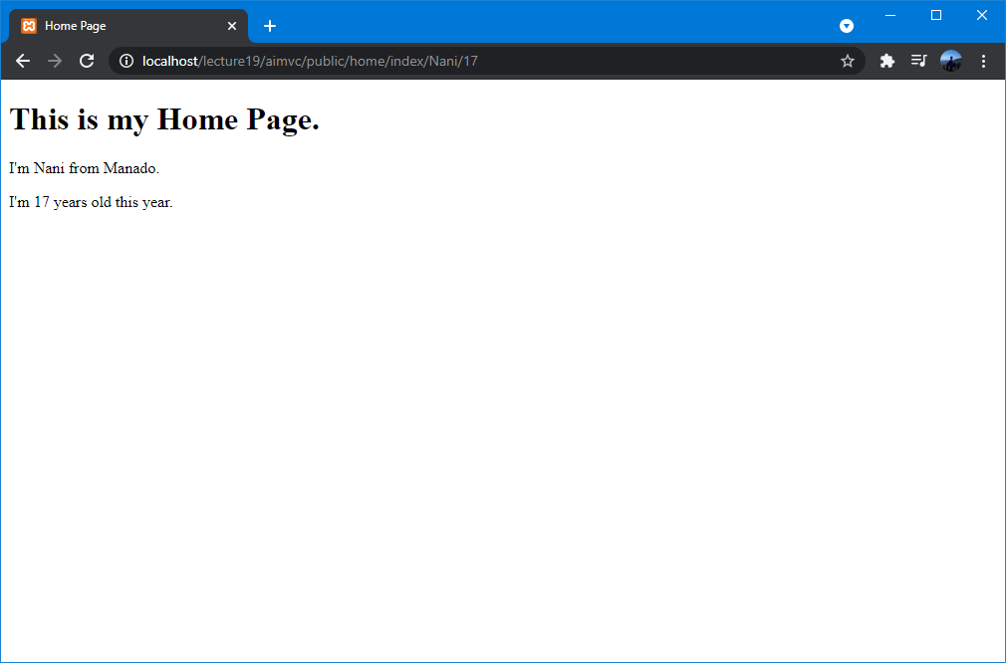
5 - Testing  Home Index Page
You can send the data and access it by following URLs:
URL: http://localhost/lecture19/aimvc/public/home/nani/17/
http://localhost/lecture19/aimvc/public/home/index/nani/17/

Slide 25
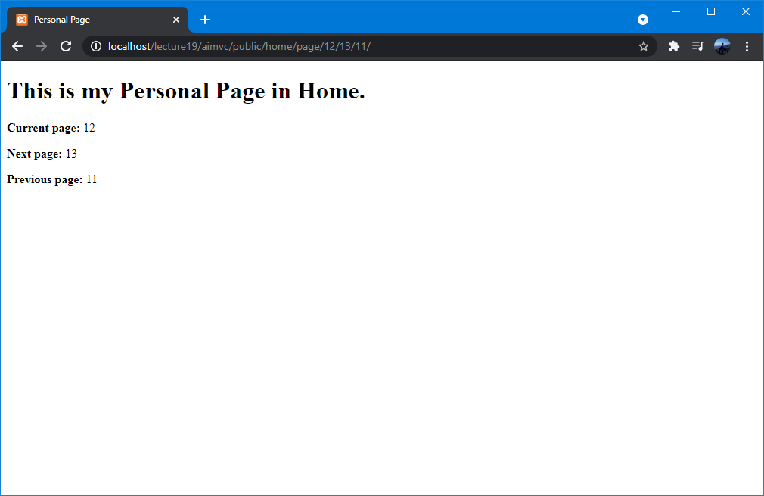
6 - Testing  Home Personal Page
You can send the data and access it by following URLs:
URL: http://localhost/lecture19/aimvc/public/home/page/12/13/11/

Slide 26
4 – Create Header & Footer Templates with their Title Page

Slide 27
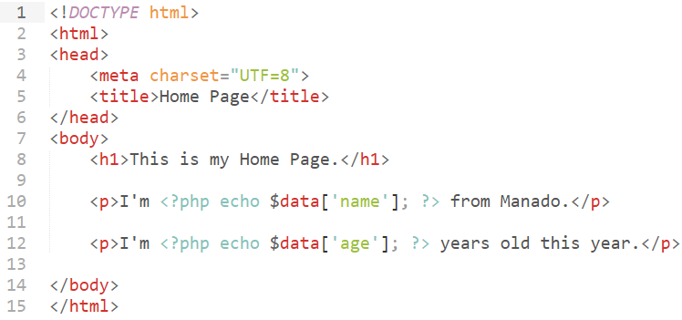
HTML Header & Footer Templates
Header
Footer
You can easily create sticky or fixed header and footer template using the CSS fixed positioning. Simply apply the CSS position property with the value fixed in combination with the top and bottom property to place the element on the top or bottom of the viewport accordingly.

Slide 28
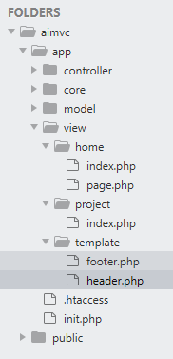
1 – Create Template Directory in View
Create one subdirectory in view. This template directory can store header and footer templates and those files can be used as a template for all php pages in our framework project.

Slide 29
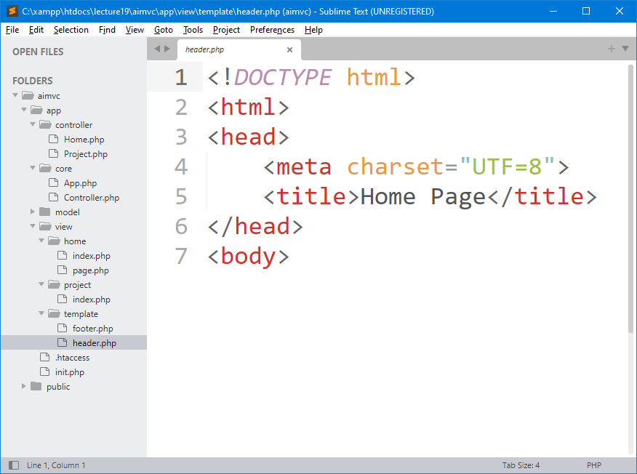
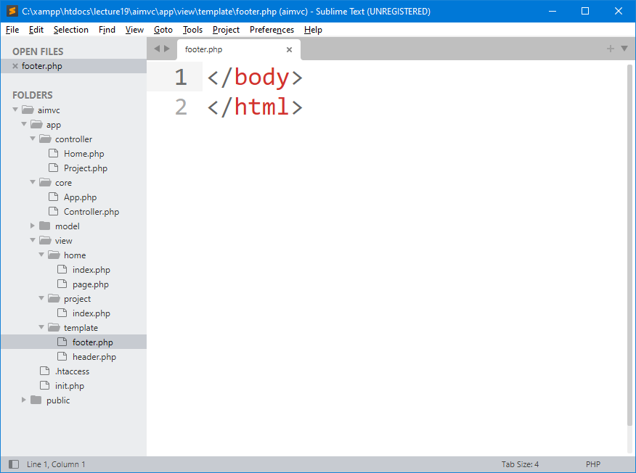
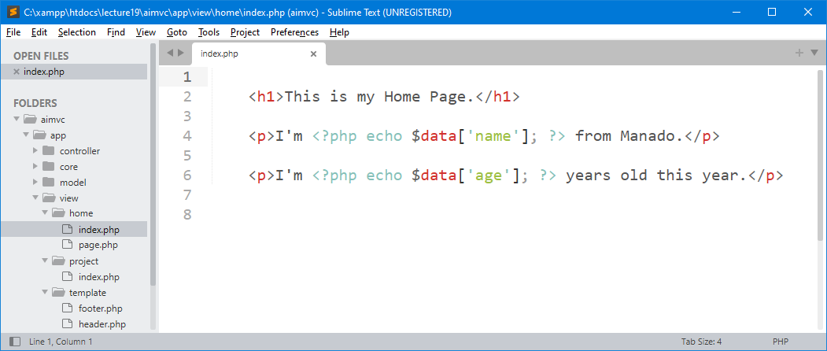
2 – Header, Footer & Content Sections
header.php
footer.php
/view/home/index.php

Slide 30
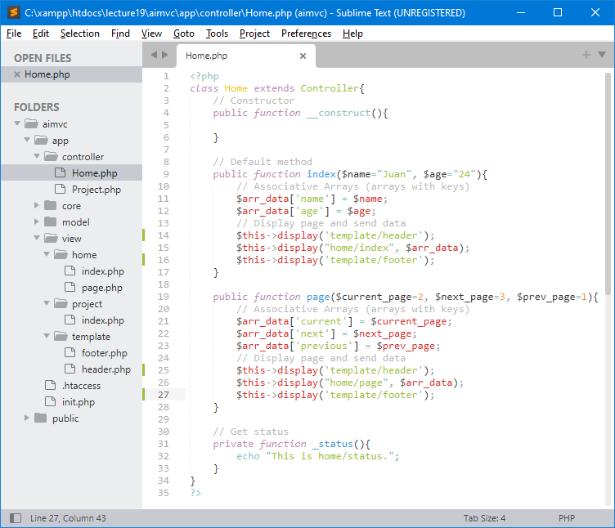
3 – Add Header & Footer in Controller
Header
Footer
Header
Footer

Slide 31
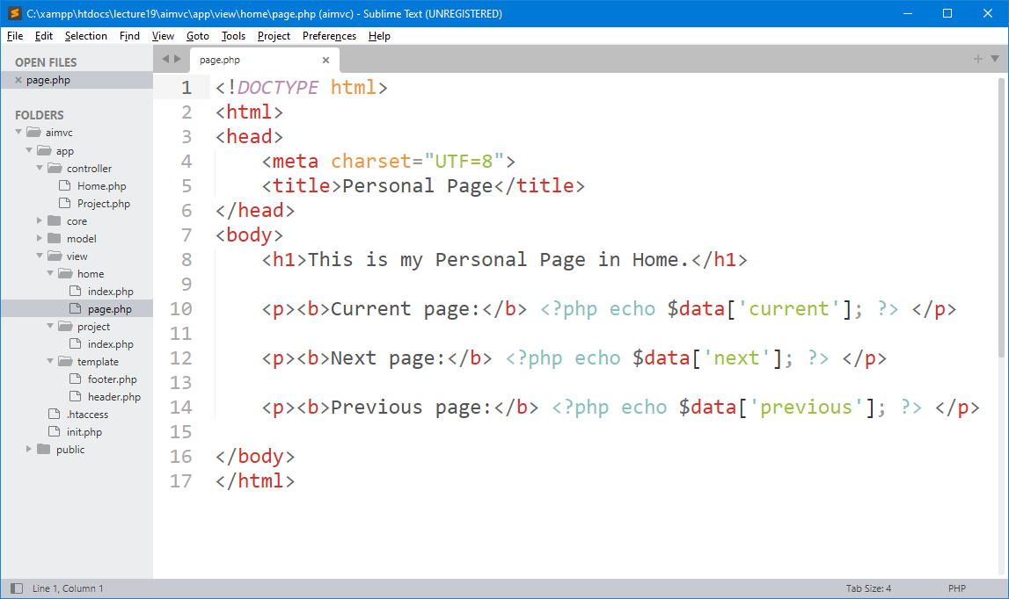

4 – Don’t Forget !!!
You my need to remove header and footer in /view/home/page.php file.
Header
Footer

Slide 32
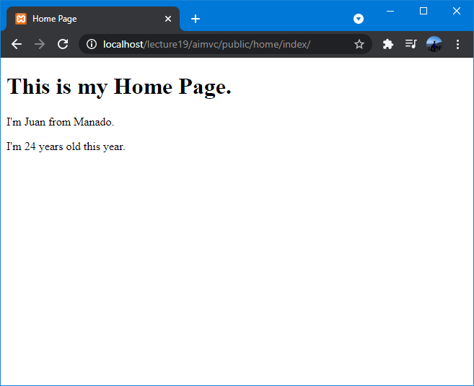
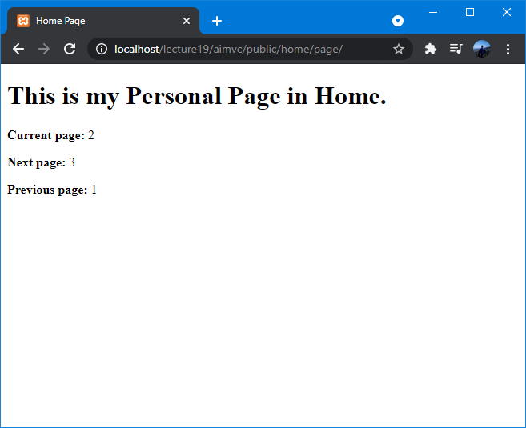
5 - Testing  Home and Personal Pages
Wrong here !!!
Problem:
Both pages still display the same title page. If you check from previous slide. Our /view/home/page.php file assigned with title page “Personal Page”.

Slide 33
5 – Send Title Page from each Method

Slide 34
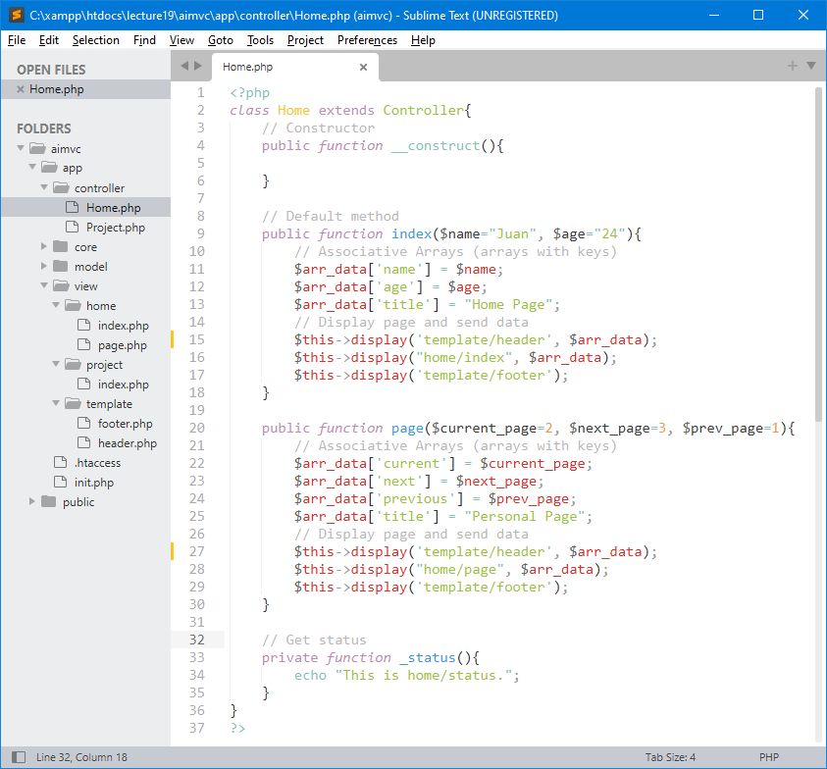
1 – Send Title Page using Associative Arrays
Title Page
Array data also need to send as a parameter in display function.
Title Page
Array data also need to send as a parameter in display function.

Slide 35
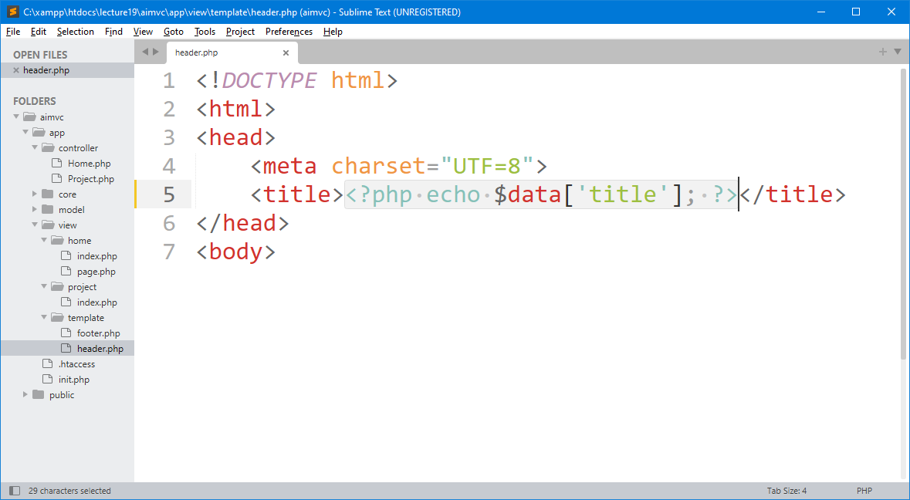
2 – Modify header.php file in Title Tag
Change following line of code: From : <title>Home Page</title>
To : <title><?php echo $data['title']; ?></title>

Slide 36
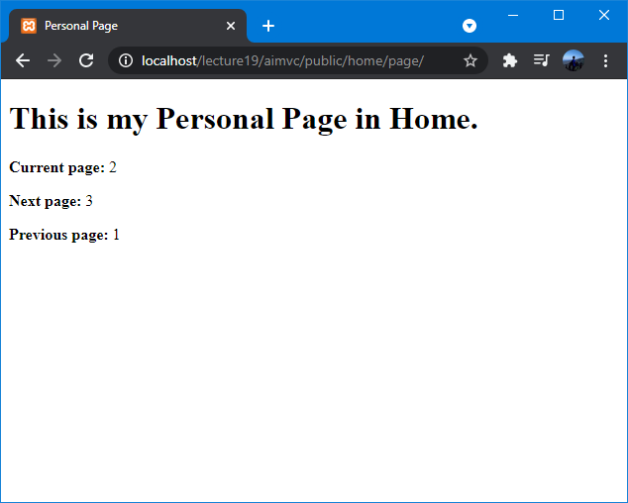
3 - Testing  Home and Personal Pages
It’s correct Now !!!

Slide 37

exercise for students

Slide 38
Latihan untuk Students
Create directory : C:\xampp\htdocs\lecture19\
Create file : _.php
Buat semua contoh yang sudah di pelajari sebelumnya di lecture ini.

Slide 39

THANK YOU
END PRESENTATION
Thank you for your attention
Instructor: S – W – T

